Slide 1
CUS 1166 – Software Engineering Technology Presentation
Flask-Dance
Manjit Kaur
4/03

Slide 2
Overview –What is OAuth?
OAuth (Open Authorization) is not an authentication framework as some developers perceive it to be.
It is an authorization framework which allows a third-party application to get access to users’ resource or data.
OAuth 2.0 is an open source protocol which allows users to share their resources with a third-party application without exposing user credentials.
For example, if a user wants to sign up or log in to a web application, the user can choose to do so via their Facebook or GitHub account (assuming developers have made it possible).
Notes:
Provide any information need to orient the audience what topic you are about to present.

Slide 3
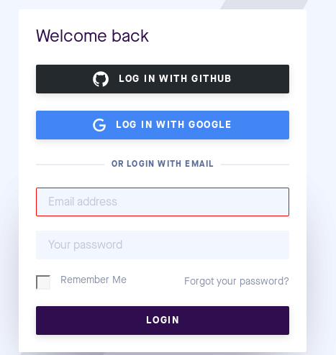
Overview –What is OAuth?
Here is a screenshot example to the login page of Pusher, where the user can log in with either their GitHub or Google account.
https://gyazo.com/cd6251dfa6e49d895bec39870d268f00
Notes:
Motivate. what problem does this technology tries to solve; What is its purpose

Slide 4
Purpose/Goal of Technology
Flask developers can make use of Flask-Dance to implement OAuth in a Flask-based application
Flask-Dance makes it possible for developers to allow users to log into a web application via their GitHub, Twitter, or even Dropbox account
While it doesn’t guarantee 100% protection from cyber attacks, by using Flask-Dance to integrate OAuth in a web application, it makes it difficult for attackers to sniff user’s credentials
Instead of users handing their credentials over to third-party clients, OAuth allows users to give access right to third-party clients by providing tokens instead of password.
Notes:
Identify possible use cases, examples, problems someone could consider using this technology.

Slide 5
Use Cases
Integration with existing services
Allows user to login through a secure third party
Registration Bypass
User is not required to create another account
Stores unique token per integrated account (for every session)
Encrypted token to provide security
Notes:
Introduce any background, key concepts and terminology needed for the audience to understand the technology your are presenting.

Slide 6
Background – Key Concepts
Allows users to grant permission to securely share information from one website to another.
Bypasses user registration by allowing users to sign in with a well-known OAuth provider like Google or Facebook.
User management systems are not necessarily required
A simple website with text field and submit button
When a tweet it submitted through a website, it uses the Twitter API to post that tweet to the linked Twitter account
Notes:
Introduce any background, key concepts and terminology needed for the audience to understand the technology your are presenting.

Slide 7
Getting Started Tutorial
Notes:
Present a getting tutorial; this should cover the basic activities for someone to start using the technology and solving a basic problem using this technology (This might need more that one slides)

Slide 8
Getting Started Tutorial
Notes:
Present a getting tutorial; this should cover the basic activities for someone to start using the technology and solving a basic problem using this technology (This might need more that one slides)

Slide 9
Getting Started Tutorial
Notes:
Present a getting tutorial; this should cover the basic activities for someone to start using the technology and solving a basic problem using this technology (This might need more that one slides)

Slide 10
Getting Started Tutorial
Notes:
Present a getting tutorial; this should cover the basic activities for someone to start using the technology and solving a basic problem using this technology (This might need more that one slides)

Slide 11
Getting Started Tutorial
Notes:
Present a getting tutorial; this should cover the basic activities for someone to start using the technology and solving a basic problem using this technology (This might need more that one slides)

Slide 12
Resources
https://flask-dance.readthedocs.io/en/v0.8.1/index.html
Part 1 Connecting to Github & Twitter
https://www.youtube.com/watch?v=MiHVTHzIgyE
Part 2 Integrating Flask-Dance with SQL Alchemy
https://www.youtube.com/watch?v=G44Tpi58dcc&t=1167s
Notes:
Resources for further reading. Provide a list of resources to help your classmates to learn more about this technolgy.

